Slide 1

Welcome!
Unmute or share in the chat:
Name
Role & State
And…
Something that’s on your summer bucket list

Slide 2
Suicide and Self-Harm Prevention Topic Call
Cohort 2: Topic Call 7
July 9, 2026

Slide 3

Funding Sponsor
The Children's Safety Network is supported by the Health Resources and Services Administration (HRSA) of the U.S. Department of Health and Human Services (HHS) under the Child and Adolescent Injury and Violence Prevention Resource Centers Cooperative Agreement (U49MC28422) for $800,000 with 0 percent financed with non-governmental sources. This information or content and conclusions are those of the author and should not be construed as the official position or policy of, nor should any endorsements be inferred by HRSA, HHS or the U.S. Government.

Slide 4

CSLC Confidentiality & Data Sharing Agreement
All materials provided by CSN (via our CSLC web portal, CSLC e-mails, and CSLC Calls) and data submitted to the CSLC are for use only within the CSLC and are not to be shared without the explicit consent of CSN staff and/or the individual state representatives who have submitted that data.

Slide 5
Engagement
Closed Captions can be viewed by clicking the CC button on your toolbar
We will provide verbal descriptions of slide content and chat messages.
Due to agency policy we cannot allow AI bots to attend CSLC meetings and events.
Use the chat feature to ask questions and make comments throughout.
Please stay muted when not speaking.
Please turn your camera on, if
able, to facilitate engagement.
Rename yourself with your state abbreviation and full name.

Slide 6

Community Guidelines
We ask during today’s session that you:
Focus on intentional presence
Bring a curious stance
Be partners in learning
Honor others' perspectives, experiences and learning styles
Take care of yourself as needed

Slide 7

Today’s Agenda
Welcome and opening chat
Harvesting the change discussion
State updates and discussion
Upcoming events, reminders and closing

Slide 8

Harvesting the Change Surveys
Purpose: Help identify opportunities to improve the change packages by gathering data on the use and usefulness of the change package.
Discussion:
Was there anything missing? (e.g. you were working on something that was not captured by a change idea)
Were the change ideas a good fit for your work?
Are there any changes you would suggest to the change ideas or measures for cohort 3?
What about the topic calls and STAWs – how could we make them more useful?
Notes:
This is OUR continuous improvement strategy!
How can we improve the strategies and measures in our change package to better help you be successful in your work?
Question about how the strategies/measures enable collecting data for you to know if improvementis hap

Slide 9
State Updates/Questions/Discussion
Brainstorm next steps
Share a success
Give a brief update
Ask questions
Share a resource
Make connections

Slide 10

What’s Next?
Apply for cohort 3
Share information about applying to the CSLC with your contacts
Submit monthly reports
Update team enrollment as needed
Reach out for TA anytime

Slide 11
Looking Ahead to Cohort 3
Children’s Safety Learning Collaborative Applications Opened June 22!
Continuing teams need to complete a brief continuation confirmation form instead of the full application.
Bullying Prevention
Motor Vehicle Traffic Safety
Suicide and Self-Harm Prevention
Sudden Unexpected Infant Death Prevention
Cohort 1 December 2023 - April 2025
Cohort 2
May 2025 – October 2026
Cohort 3 November 2026 - April 2028

Slide 12
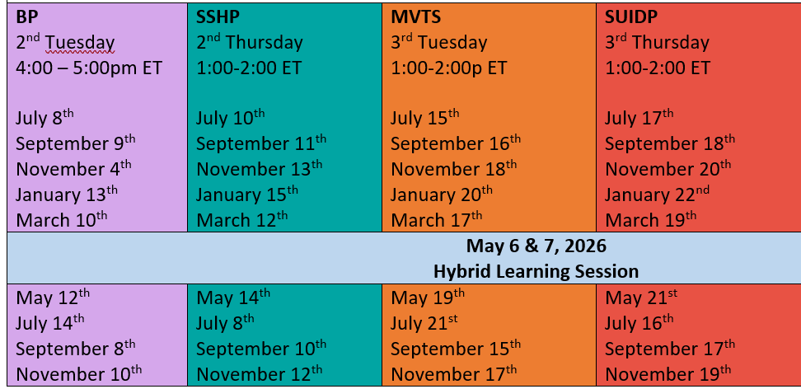
Office hours every other month between topic calls
STAWs are open to all! Please share with partners and colleagues.
​No registration required!​ Recurring link to join: ​go.edc.org/STAW

Slide 13

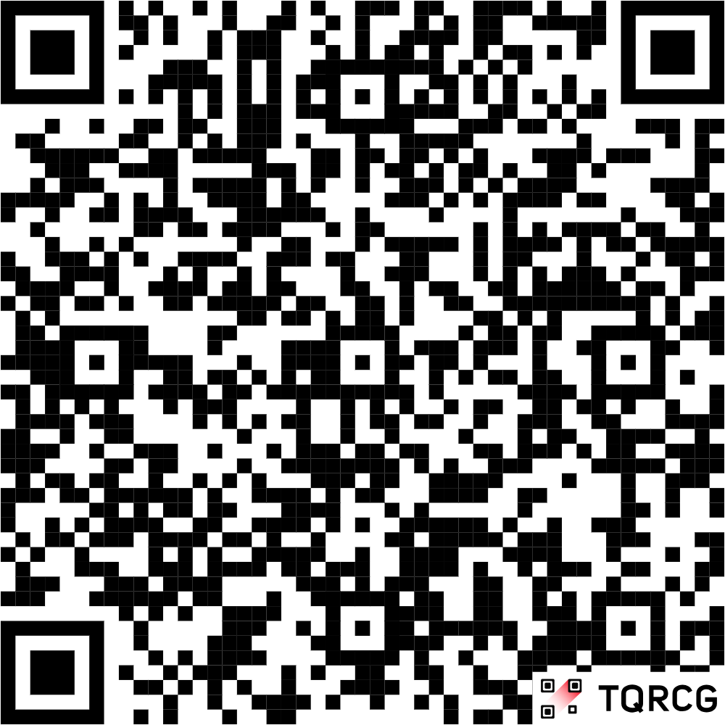
State Technical Assistance Webinar
Managing your Child Safety Work through Long and Short-Term Goals
August 19, 2026 2:00-3:00p ET
No registration required!
Open to all!
Join with this link:

Slide 14
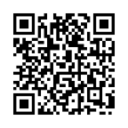





Thank you!
Visit our website and follow us on social media
Please fill
out our brief evaluation:
childrenssafetynetwork.org
Children’s Safety Network
Children’s Safety Network
@ChildrensSafety
Children’s Safety Network
Notes:
July eval link: https://edc.co1.qualtrics.com/jfe/form/SV_6mzP1QqPl2DTqZw

